Slide 2

Content
Standard & Legislation in General
  Role of standards in enhancing the trade
Smart Grid & Smart Cities in Europe
  Policies & Standards Update
Smart Grid & Smart Cities in India
  Policies & Standards Update
Conclusion
2

Slide 3
Standard & Legislation in General
(Role of standards in enhancing the trade)

Slide 4

What is a standard?
It is a document that defines technical or quality requirements with which current or future products, production processes, services or methods may comply

Slide 5

Why standards are important?
Enhance safety of products
Promote common understanding
Facilitate trade by reducing TBs
Promote interoperability of
products and services
Benefits of economies of scale
Support environmental sustainability
Facilitate the uptake of innovation and reflect the outcome of research and development

Slide 6

Standards vs Législation
Standards :
Voluntary & Consensual
Developed by independent organisations
Revised every 5 years
Provide specifications and test methods (interoperability, safety, quality, etc.)
Legislation :
Mandatory & Imposed by Law
Established by public authorities
Revised when legislators decide
Gives requirements to protect public interests

Slide 7



International Standards
- It’s a time of global economy [globalisation]
- Standards are the valuable tool for global trade

Slide 8








SDO’s are integrated with International - Europe
To avoid duplication of work at International and to aim for a identical worldwide standards
CEN: 32% of portfolio identical to ISO
CENELEC: 72% of portfolio identical to
(+ another 6%based on) IEC standards
“Vienna Agreement” with
Chemistry, Material, Energy, Environment, Transport, Construction, Services, eMobility etc
“Frankfurt Agreement” with
Electricity, Electro-technical
MoU for telecommunications sector (ITU-T), Agreement on radio-communication sector (ITU-R)
Founding Partner to 3GPP & oneM2M
Information & Communication Technologies (ICT)

Slide 9


SDO’s are integrated with International - India
To avoid duplication of work at International and to aim for a identical worldwide standards
BIS: 25% of portfolio identical to ISO
BIS: 55% of portfolio identical to
(+ another 6%based on) IEC standards
Founding Member
Chemistry, Material, Energy, Environment, Transport, Construction, Services, eMobility etc
Member since 1911
Electricity, Electro-technical
MoU for telecommunications sector (ITU-T), Agreement on radio-communication sector (ITU-R)
Organisation Partner to 3GPP & oneM2M
Information & Communication Technologies (ICT)

Slide 10
Smart Energy in Europe
Policies & Standards

Slide 11
EU context
The EU 20/20/20 targets
  20% cut in greenhouse gas emissions (from 1990 levels)
  20% of EU energy from renewables
  20% improvement in energy efficiency
The EU framework on climate and energy for 2030 with more ambitious targets to reduce greenhouse gas emissions by 40% and increase the use of renewables to at least 27% by 2030
At EC level, DG ENER established the EC Task Force on Smart Grids in 2009 with the task to advise the EC on policy and regulatory frameworks
No plan to adopt specific Smart Grids legislation but push to progress on deployment however issued M/490 (Requesting ESOs to study and develop standards for EU
CEN, CENELEC & ETSI are working with the EC and other stakeholders to develop and adopt European Standards to support the implementation and the successful integration of the European energy market and the implementation of the EU’s climate and energy targets
Notes:
A smart grid is an electricity network that can integrate in a cost-efficient manner the behaviour and actions of all users connected to it (generators and/or consumers) in order to ensure economically efficient, sustainable power system with high levels of quality and security of supply and safety. Smart grids allow companies and households to produce electricity (for example – using photovoltaic panels or wind turbines) and sell it on to other consumers through existing networks.

Slide 12
M/490 & Associated Work
M/490 on Smart Grid deployment in Europe
Objective = to develop a framework to enable the ESOs to perform continuous standard enhancement and development in the field
In order to perform the requested work, the ESOs combined their strategic approach and established in July 2011, together with the relevant stakeholders, the CEN-CENELEC-ETSI Smart Grid Coordination Group (SG-CG), being responsible for coordinating the ESOs reply to M/490
Reports issued as ESOs reply to M/490 by 2012

Slide 13
M/490 & Associated Work
Available Reports end 2012
A technical Reference Architecture, which represents the functional information data flows between the main domains and integrates many systems and subsystems architectures
A first Set of Consistent Standards, which supports the information exchange (communication protocols and data models) and the integration of all users into the electric system operation
Sustainable Standardization Processes and collaborative tools to enable stakeholder interactions, to improve the two above and adapt them to new requirements based on gap analysis, while ensuring the fit to high level system constraints such as interoperability, security, and privacy, etc...
The ESOs investigated how standards can be used to develop Smart Grid information security and data privacy concepts useful to all Smart Grid stakeholders to integrate information security into their daily activities.

Slide 14
M/490 & Associated Work
M/490 extended till December 2014 to:
Refine the methodology developed in 2012
Prepare an extended set of standards by end 2014
Investigate Interoperability aspects
  system interoperability testing method
  conformance testing map and assessment of needed profiles

Slide 15
M/490 & Associated Work
In December 2014 the SG-CG published the following reports:
Extended Set of Standards to support Smart Grids deployment
Smart Grid Interoperability
Smart Grid Information Security
Overview of Smart Grid Methodology (incl. annexes: General Market Model Development, Smart Grid Architecture Model User Manual and Flexibility Management)
In parallel, SEG-CG attracted and facilitated the active contribution of regional standardization bodies from Japan (JISC), the US (SGIP), Canada (SCC), Africa (AFSEC)and India (Indian National Committee)
Notes:
METHODOLOGY: Clarify new elements like role model, conceptual model, market models/Describe in detail SGAM: a pivotal element of the methodology /Illustrate the use of SGAM on examples
SET OF STANDARDS
To update the list of Smart Grids standards gaps and rank these gaps based on stakeholders priorities
To set-up/boost associated standardization works to fill these main gaps, and monitor them through a periodic update
To update the “Set of standards” document, based on new inputs
DG ENER organized, together with CEN, CENELEC and ETSI, a European conference on smart grid standardization achievement on 26 February 2015. The objective was on one hand to disseminate the results of the SEG-CG work under M/490 and on the other hand, to get industry views on the work achieved so far. The feedback received during the event was highly positive and the audience encouraged the SEG-CG to pursue its work on the dissemination and wide implementation of the standards by the industry, on cybersecurity and data protection and privacy and interoperability.

Slide 16
Today
Focus now on implementation and promotion
WG Set of Standards
  2016 Deliverable: an updated Set of Standards supporting Smart Grids deployment in Europe and ranking process of those gaps with the aim to carry out a prioritization leading to the update of smart grids standardization gaps by end 2016.
WG Cyber Security and Privacy
  2016 Deliverable: security standardization specific to Smart Energy Grids and security standardization targeting generic standards were further monitored and analysed with the focus on two specific use cases (decentralized energy resource DER and substation automation).
Ad Hoc Group Clean Energy Package
  The objective of the “AHG-CEP” is to ensure that CEN, CENELEC and ETSI will support the deployment of the outcome of the EC’s proposals for new rules for consumer-centred clean energy transition by providing the adequate set of standards. Kick-off meeting in September 2017.

Slide 17
Activities of CG-SEG
Where to find SEG-CG activities and results in the process
Report Method
Use Case Repository
Report Set of Standards
Work program
Gap List
Report Interoperability
Interoperability Testing
Pre Standardization
Standardization
Post Standardization
Collection
Use Cases
Require-
ments
New Work
Item
Std.
Developm.
Conformity
Assessm.
Implemen-
tation
IOP
Testing
Steps
Report
Method/Set of Standards
SGAM Mapping
Report
Set of Standards
Set of Standards
Report Information Security
Smart Grid Information Security
CG-SEG has explicitly worked on Pre- and Post-Standardization
Notes:
17

Slide 18
Smart Cities in Europe
Policies & Standards

Slide 19










EC RnD Projects encouraged to Standardize:
H2020 Lighthouse Projects
Notes:
Explored techniques for Replication of Smart City solutions

Slide 20
EC R&D Projects encouraged to Standardize:
H2020 Lighthouse Cities (and others)
GrowSmarter: Stockholm, Cologne, Barcelona
mySMARTLife: Nantes, Helsinki, Hamburg
REPLICATE: Bristol, San Sebastian, Firenze
RUGGEDISED: Umeå, Rotterdam, Glasgow
Sharing Cities: London (Greenwich), Lisbon, Milan
SmartEnCity: Vitoria-Gasteiz, Sonderborg, Tartu
SMARTER TOGETHER: Wien, Lyon, München
REMOURBAN: Valladolid, Nottingham, Tepebasi/Eskisehir
Triangulum: Manchester, Eindhoven, Stavanger
www.smartcities-infosystem.eu/sites-projects/projects

Slide 21







EC R&D Projects encouraged to Standardize:
H2020 IoT Large Scale Pilots
Management of Networked IoT Wearables – Very Large Scale Demonstration of Cultural and Security Applications – www.monica-project.eu
ACTivating InnoVative IoT smart living environments for AGEing well - www.activageproject.eu
AUTOmated driving Progressed by Internet Of Things – www.autopilot-project.eu
Internet of Food and Farm 2020 - www.iof2020.eu
Delivering an IoT enabled Digital Single Market for Europe and Beyond – www.synchronicity-iot.eu
User Engagement for Large Scale Pilots in the Internet of Things - www .u4iot.eu
CRoss FErtilisation through AlignmenT, Synchronisation and Exchanges for IoT – www.create-iot.eu
www.european-iot-pilots.eu

Slide 22



Why Standards for Smart Cities ?
Underpinning common understanding
Enabling integration between systems, and between the physical and the digital world
  Accelerating smart city solutions and deployment
  Provide confidence in the market
  Preventing vendor lock-in
  Enabling scaling and replicability of urban solutions
  Facilitating a collaborative, consensus-driven process open to all stakeholders
  Because STD will create Smart Cities!
    … in response to the market and final beneficiaries needs (cities and citizens)
Notes:
STD can help provide a shared common language and this is critically important because of the wide set of stakeholders involved.
Phy and DIG= cities need reliable and resilient physical and tech infrastructures, working together
One of the most important characteristic of SC is interoperability and coherence between separate systems and services. STD can help define those points of interoperability
The ESOs and their members have an enormous n of std developed in several TCs existing or proposed that are relevant for sc. At the present those TSD broadly concern specific issues rather than dealing with horizontal cross-cutting issues. This is issue is likely to continue since dedicated std are needed for individual applications (transport, healthcare), but a common framework is needed that’s why the CG
Market They can support industrialization of solutions and Speed replicability
- STD can help prevent vendor lock-in = when products and services are built to widely agreed std, it makes it possible to break things down into smaller parts and find the best providers of each of them, rather than having to contract with a single company to offer the whole product.
-STD enabling scale= the use of std ensure cities are following a path taken by many others. Having many cities following a common path will stimulate the market to further support this path and the roll-out of integrated, scalable SC solutions
-STD help to develop and manage a SSCC Strategy and Implementing and managing Smart City projects (align approaches), is the complexityof the city itself and of the (decision-making) processes that need to be put in motion
- Standards are enablers for the seamless integration of city systems, functions, applications and services and for the technologies and communications infrastructures underpinning these.

Slide 23



























































Cities need help in the Specifications Jungle
De Jure SDOs
De Facto SDOs
Promoting
ITU-T
ITU-R
JTC1
SG-20
European ESOs:
CEN
CENELEC
National SDOs:
AIOTI
UK
Japan
...
Open-Source
Notes:
Looking at the general kinds of Standards Developing Organisations
there are three types:
De-Jure: bodies whose specifications are referenced by government contracts and in laws
De-Facto: bodies whose specifications are so widely used that they cannot be avoided,
so called "industry standards"
Promoting: bodies which do not themselves (usually) create specifications,
but do promote certain specifications and guidelines ("profiles")
or do promote the business cases for areas where interoperability is important

Slide 24





Global & EU Standardization activity
ISO/TMB/
Smart Cities SAG + TF
ISO/TC 268 ISO/TC 268/SC 1
IEC SyC
Smart cities
Jointly with IEC and ITU
CEN-CENELEC-ETSI Sector Forum on SSCC
ITU-T/FG
SSC
ISO-IEC/JTC 1 WG 11
Advisory & Strategic Group of the ESOs
Technical Committees
Recommendations and coordination
No standardization development
Standardization Development
(Standards, TS, TR, PAS…)

Slide 25
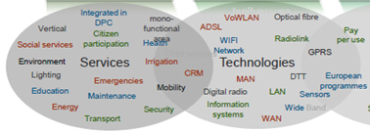
Standards shrink risks in Enabling Technologies
Fixed:
xDSL, Fibre, PoF, PLT, NGN, SDN/NFV, co-axial (cable)
Wireless:
Wi-Fi, Digital Radio, Wide band, narrow band, LTE -> 5G, Satellite, NFC, RFID
Horizontals / Platforms:
Security/privacy, Energy efficiency, M2M, QoS/QoE, Interconnect & Interop, Secure IT platform & data management, semantics, Human Factors

Slide 26
The Sector Forum SSCC
SF-SSCC is a joint strategy & advisory group of the European Standardization Organizations (ESOs) that acts as an advisory and coordinating body for European standardization activities related to Smart and Sustainable Cities and Communities
Liaise with relevant international initiatives with the aim to monitor standards already publicly available that meet specific needs for smart and sustainable cities and communities (SSCC)
Analyze and recommend standards for development, implementation, adaptation, or revision by the ESOs (CEN, CENELEC and ETSI)
Discuss the relevance of the adoption of existing international standards at European level and make recommendation to the Boards

Slide 27
Tasks of the SF-SSCC
Organize a series of annual event (at least once a year) about standardization for SSCC open to all relevant stakeholders as to collect needs, share experiences and favor the exchange of best practices and replicable solutions in cities and communities
Permanent link and collaboration with the European Innovation Partnership on Smart Cities & Communities (EIP - SCC)
Identify and give due consideration to European innovation and research projects dealing with standardization for smart and sustainable cities which might impact the field/subject
Notes:
(such as those within ISO, IEC and ITU)

Slide 28
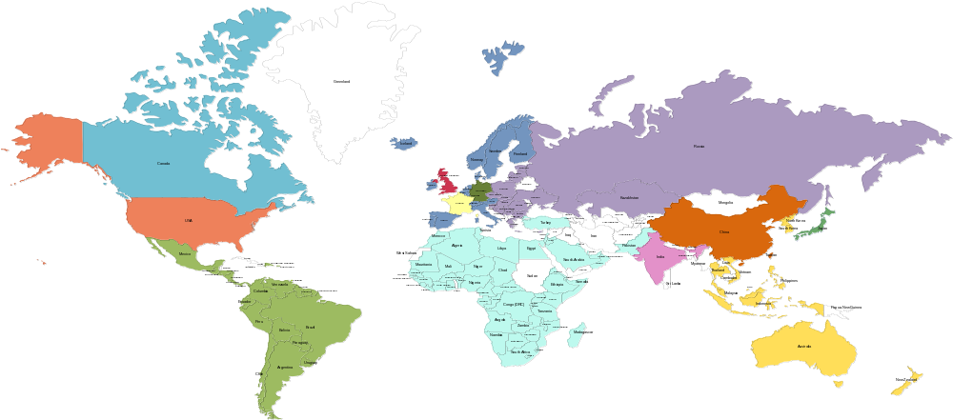

















oneM2M Partnership Project
Over 200 member organizations in oneM2M
www.oneM2M.org
All documents are publically available
Source: oneM2M
28
9
© ETSI 2017. All rights reserved
Notes:
oneM2M is a global partnership project, between 8 of the world’s leading ICT standards development organizations, 7 other partners (standards development organizations like CEN and CENELEC who have recently joined, or OMA, Broadband Forum, GlobalPlatform etc.)
Over 200 companies have participated in the development of the oneM2M specifications. – a set of 10 specs. Published in January 2015, recently updated in 2016. The specifications are all published by the 8 partner standards bodies, making a common set of IoT/M2M specifications across North America, Europe and Asia.

Slide 29
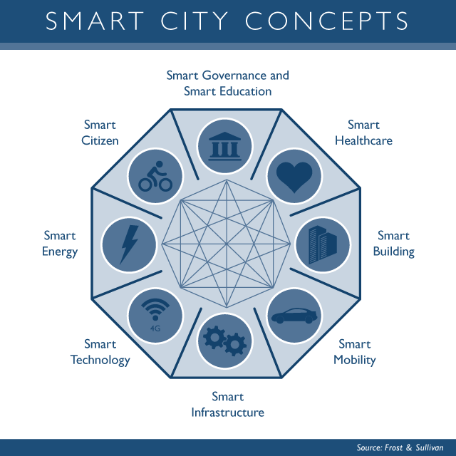
Vision for building smart cities
2. Digitalize and «sensorise»
1. Build a vision
3. Build Dashboards
4. Expand the vision, Integrate and Innovate
Source: Based on discussions with Dr. Martin Serrano,
OASC and Insight centre

Slide 30
Key requirements for smart city IoT platform
Horizontal platform for new deployments
Smart city is an incremental and participatory journey
New deployments should, where possible, leverage a converged networks and an horizontal service platform
Open standards are key to avoid lock-in and master the total cost of ownership
Existing deployments
Do not disrupt existing “vertical deployment” but seek opportunities for an integration path with an horizontal approach
Build value through mash-ups and open data
Participatory and innovative approach
Surveys
Address needs for innovation through app development:
  APIs
  Access to, eventually semantically enriched, Open data (where feasible and subject to privacy legislation/citizen consent)
Security and (device) management are key
Despite initial focus on IoT data, there is an increased interest in security and device management (which go hand in hand).
Need arises from security threat analysis conducted recently: e.g. ”Two researchers analyzed smart meters widely used in Spain and discovered that those can be hacked by attackers to harm the overall National power network.”, source: http://securityaffairs.co/wordpress/29353/security/smart-meters-hacking.html

Slide 31















A possible smart city blue-print
Cloud apps
Dashboards
City Apps
3rd party apps
Analytics apps
Dashboards
City Apps
3rd party apps
Analytics apps
REST
APIs
REST
APIs
SPARQL or
REST APIs
Smart city backend
Open data
(Semantics)
Group mgmt
Data
Mgmt
Cloud
VM Mgmt
Location
Big Data Storage
Big Data enablers
Broker
Other data
sources
I/F to other
IoT platforms
Discovery
Adapter
Existing
deployments
Device
Interworking
Adapter
Smart city frontend
Security
App
App
App
Data center
Device mgmt
Field domain
Gateway
Gateway
Device
D
D
D
D
D
D
D
D
D
LWM2M

Slide 32
Smart Energy in India
Policies & Standards

Slide 33
Journey till date – 1
Realizing the growing importance of Smart Grid technologies in the Indian power sector, the Ministry of Power (MoP) had taken early steps in 2010 by constituting the India Smart Grid Task Force (ISGTF) and the India Smart Grid Forum (ISGF).
India Smart Grid Task Force
India Smart Grid Forum
Pilot Projects
Inter-ministerial group created under MoP to provide policy direction to the Smart Grid initiatives in the country.
Non-profit voluntary consortium of public and private stakeholders with prime objective of accelerating development of Smart Grid technologies in Indian Power Sector.
11 Smart Grid and 1 Smart City pilots sanctioned with 50% funding support from MoP, GoI to test various Smart Grid technologies.
There are also several additional initiatives that various entities have been undertaking working in their domain for Smart Grid support and implementation in India such as CEA, BIS, CPRI, BEE, etc.
Source: NSGM

Slide 34
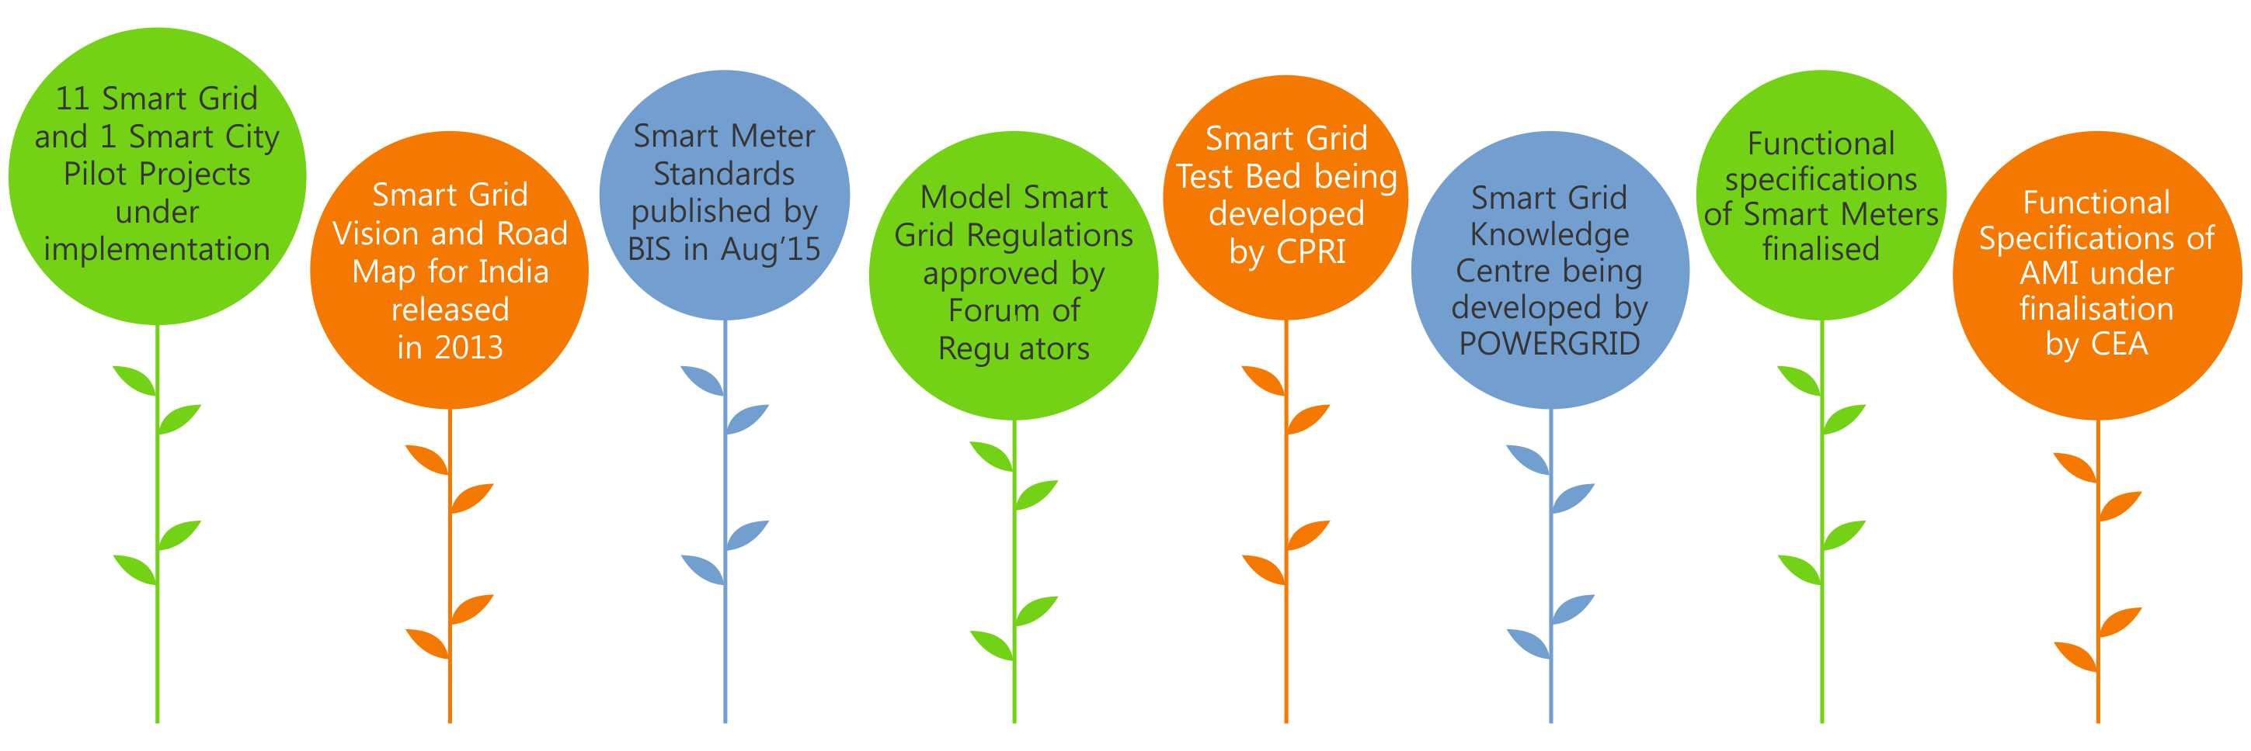
Journey till date – 2
l
Source: NSGM

Slide 35

National Smart Grid Mission
The Government of India approved the establishment of a National Smart Grid Mission (NSGM) in Power Sector. (OM issued on March 27, 2015)
NSGM to plan and monitor implementation of policies and programmes related to Smart Grid activities in India.
NSGM - Project Management Unit (NPMU) housed in POWERGRID -Single point contact for GoI’s views on Smart Grid.
NSGM will have its own resources, authority, functional & financial autonomy.
The total outlay for NSGM activities for 12th Plan: Rs.980 crore (132M Euro) with a budgetary support of Rs.338 crore (45.6M Euro)
Source: NSGM

Slide 36




National Smart Grid Mission – Scope
Deployment of Smart Meters and AMI.
Substation Renovation and Modernization with deployment of Gas Insulated Sub-stations (GIS).
Development of Distributed Generation in form of Roof Top PVs.
Real-time monitoring and control of DTs.
Provision of Harmonic Filters and other power quality improvement measures.
Creation of EV Charging Infrastructure for supporting proliferation of EVs.
Development of medium-sized Micro-grids.
Source: NSGM

Slide 37
Status of Smart Grid Pilots Projects
Sl. No. | Utitlity | Date of Award | Sanctioned Cost (Euro - M) | Evaluated / Award Cost (Euro - M) | Financial Progress (Euro - M) | Smart Meters 1φ |  | Smart Meters 3φ |  | Total Meters Inst.
 |  |  |  |  |  | Total Qty | Till date | Total Qty | Till date
1 | CESC, Mysore SGIA - Enzen | Mar'14 | 4.40 | 4.40 | 0.55 | 19487 | 17750 | 2337 | 0 | 17750
2 | UHBVN, Haryana SGIA - NEDO Japan | Apr'14 | 4.86 | - | - | 9800 | 0 | 1200 | 0 | 0
3 | HPSEB, Himachal Pradesh SGIA - Alstom | Feb'15 | 2.63 | 2.63 | 0.33 | 1118 | 885 | 436 | 180 | 1065
4 | APDCL, Assam SGIA - Phoenix IT | Mar'15 | 4.05 | 2.83 | 0.35 | 7876 | 0 | 7207 | 0 | 0
5 | PSPCL, Punjab SGIA - Kalkitech | Mar'15 | 1.37 | 0.97 | 0.12 | 1101 | 0 | 1636 | 0 | 0
6 | WBSEDCL, West Bengal SGIA - Chemtrols | Jun'15 | 0.95 | 0.96 | 0.12 | 5059 | 0 | 206 | 0 | 0
7 | TSECL, Tripura SGIA - Wipro | Sep'15 | 8.57 | 8.57 | 1.07 | 42986 | 462 | 2043 | 77 | 539
8 | TSSPDCL, Telangana SGIA - ECIL | Oct'15 | 5.65 | 4.72 | 0.59 | 8882 | 20 | 1515 | 8 | 28
9 | PED, Puducherry SGIA - Dongfang | May'16 | 6.23 | 6.23 | - | 23492 | 0 | 10007 | 0 | 0
10 | AVVNL, Ajmer SGIA - USAID PACE-D TA | Sep'15 | NA |  |  | 1000 | 1000 | 0 | 0 | 1000
11 | UGVCL, Gujarat |  | 11.18 |  |  | To be awarded Soon
12 | IIT-K Smart City Pilot |  | 1.69 | 12.50 | 4.69 | Installation in Progress
Total |  |  | 51.57 | 31.30 | 3.13

Slide 38
Status of Smart Grid Projects under NSGM
Sl. No. | Utility | Date of Award | Sanctioned Cost (Euro - M) | No. of Consumers | Status
1 | Chandigarh, CED | Under Progress | 3.86 | 29,433 | Project approved by Empowered Committee on 29.03.2016. Sanction letter issued on 22.04.2016. RECPDCL appointed as PMA on 30.08.2016
2 | Amravati, MSEDCL |  | 12.17 | 1,48,495 | Project approved by Empowered Committee on 29.03.2016. Sanction letter issued on 22.04.2016. Tender documents preparation in process.
3 | Congress Nagar (Nagpur), MSEDCL |  | 18.80 | 1,25,403 | Ex post facto approval accorded by Empowered Committee on 27.10.2016. Sanction letter issued on 29.07.2016. Tender documents preparation in process.
4. | KESCO (Kanpur) |  | 43.19 | 5.39000 | Approved by Empowered Committee on 27.10.2016
Total |  |  | 78.02 | 842331

Slide 39
Smart Grid Implementation in India
S.N. | Project Description | Project Area | Functionality | Euro - M | Consumers
1 | 11 Smart Grid Pilots (WIP) | Across India | AMI, PLM, OMS, PQM, DG, DTMU, SAS | 45.02 | 1,84,801
2 | IIT Kanpur Smart City Pilot (WIP) | IIT Kanpur | AMI, SAS, DG, HA | 1.69 | IIT Campus
3 | Smart Grid Projects under NSGM | Amravati, Congress Nagar (Nagpur) & Chandigarh | AMI, OMS, ADR, DG, DTMU, SAS | 34.84 | 3,03,341
4 | Smart Grid Project by BESCOM (WIP) | Indira Nagar (Bangalore) | AMI, PLM, DTMU, DSM, SLA, EV Charge | 5.06 | 26,911
5 | SG project at TPDDL (WIP) | Delhi | Canopy for 5 lakh endpoints AMI/DA | N.A. | 5,000 endpoints in phase 1
 |  |  | Completed ADR for managing 11.5 MW in 2015 | N.A. | 160 buildings
6 | Smart Grid Project by CESC (WIP) | Kolkata | AMI, MDMS, Comm. canopy for 4 million meters | N.A. | 1st ph- 1,87,000 Total- 7,50,000
7 | Smart Prepaid Metering on BOOT Model by JnJ Powercom | Across Odisha | Prepaid Smart Meter | N.A. | 1stPhase-4,237
 |  |  |  |  | Total- 18,046
8 | Smart Grid Demonstration Project by POWERGRID | Puducherry | AMI, OMS, PQM, DG, DTMU, SLA | N.A. | 1,658 Meters
9 | Smart Grid Pilot - PoC by UGVCL | Naroda (Ahmedabad) | AMI | N.A. | 1,500 Meters
11 | Meerut AMI project (WIP) | Meerut | AMI | N.A. | 13,751 Meters
12 | Muzaffarpur AMI project | Muzaffarpur | AMI | N.A. | 5,000 Meters
13 | Tata Power AMI project | Mumbai | AMI | N.A. | 10,170 Meters

Slide 40
Standardization work: Smart Grids and Smart Metering in India 1(4)
IEC standards that have been adopted/referred by BIS related to smart grids:
  IEC 60870
  IEC 61000 Series covering IEC 61968, IEC 61850, IEC 61970
  IE27001 C 62000 Series covering IEC 62056, IEC 62325, IEC 62351
Work by Electronic and IT Division Council (LITDC) and Electrotechical Divisional Council (ETDC)
  LITDC => Electronic and IT Division Council=> 25 Sectional Committees => LITD 10: Power system Control and associated Communications

Slide 41
Standardization work: Smart Grids and Smart Metering in India 2(4)
Scope of LITD10 is to prepare Indian standards on Power system control equipment and systems including EMS, DMS (Distribution Management System), SCADA (Supervisory Control and Data Acquisition), Distribution automation, Smart grid, Teleprotection and associated communications used in planning, operation and maintenance of power systems.
LITD 10 –Liaison with IEC/TC 57 “Power system management and associated information exchange” (P-Member) and IEC/TC 118 “Smart grid user interface (P-Member)
Also established a panel on Smart Infrastructure which is studying work of IEC SyC Smart Energy to determine relevance to India so a corresponding TC could be established and adoption could be carried out..

Slide 42
Standardization work: Smart Grids and Smart Metering in India 3(4)
Important Standards by LITD 10
  IS 15953: 2011 Supervisory Control and Data Acquisition (SCADA) system for power system applications
  IS 16334:2015 Power System Communications -Interoperability Guidelines
  IS 16335:2015 Power Control Systems -Security Requirements
  IS 16336 Series: Common Information Model (CIM) for Information Exchange in the Context of Electrical Utilities
  Ministry of Power (via Central Electricity Authority) has published FUNCTIONAL REQUIREMENTS OF AMI in August 2016
  Standard for Panel Meter, transformer-operated smart meter, Phasor Measurement System (PMU), Distribution Management System (DMS) and Digital Architecture framework are being formulated

Slide 43
Standardization work: Smart Grids and Smart Metering in India 4(4)
ETDC => ElectroTechnical Division Council=> 25 Sectional Committees
ETD13: Equipment For Electrical Energy Measurement And Load Control: 27 Standards => IEC/TC23 |P Member|
  IS 15959 : Part 2:2016 => Data Exchange For Electricity Meter Reading, Tariff And Load Control - Companion Specification Part 2 Smart Meter
  IS 16444 :2015 => A.C. Static Direct Connected Watthour Smart Meter Class 1 And 2 - Specification
ETD 40 HVDC Power Systems: 11 => IEC/SC22F |P Member|
ETD 46 Grid Integration: 0
LVDC PANEL: 0
  India Participate regularly at IEC SEG 4

Slide 44
Work on Cyber Security
ISGF-NCIIPC Cyber Security Preparedness Survey
  Top 10 Findings and Recommendations submitted to MoP in 2015
Workshops on Cyber Security for Power Systems (3 days)
  6 workshops conducted so far
  This is being ported to an E-Learning platform
Two Semester Course on Cyber Security for Power Systems
  Course content is ready; working with universities to launch
Global Smart Grid Federation (GSGF)
  ISGF is Chairing a Work Group on Cyber Security
  First Report of this Work Group issued
Indian Manual on Cyber Security for Power Systems
  Draft submitted to MoP which is under finalization

Slide 45
Smart Cities in India
Policies & Standards

Slide 46
Smart City Mission
PM Modi launched 100 smart cities mission On 25th June 2015.
Create core infrastructure
Provide a decent quality of life
Build clean and sustainable environment and application
Over Rs. 48000 cr allocated to Smart Cities for next 5 years.
Smart City Mission- Strategies :
City Improvement (Retrofitting)
City Renewal ( Redevelopment)
City Extension ( Greenfield)
Pan City Initiatives ( Smart Solution)
Smart City Mission- Convergence with other Government Schemes:
Atal Mission for Rejuvenation and Urban Transformation (AMRUT)
Heritage City Development and Augmentation Yojana (HRIDAY)
Swachh Bharat Mission (SBM)
Digital India
Housing for All

Slide 47
Smart City Mission
Mission monitoring
National level (An Apex Committee (AC), headed by the Secretary)
State level (State Level High Powered Steering Committee (HPSC) chaired by the Chief Secretary)
City level (CEO of the SPV will be the convener of the Smart City Advisory Forum)

Slide 48
Criteria for Smart Cities
Smart City Mission- Selection process : Each aspiring city competes for selection as a smart city in what is called a ‘City Challenge’.
There are two stages in the selection process:
      Stage 1 of the competition: Shortlisting of cities by States
      Stage 2 of the competition: The Challenge round for selection
Fund released and distribution:
      Fund can be used as follows-
      Project fund: 93%
      State/ ULB ( Administrative and office expenses): 5 %
      MOUD (Administrative and office expenses): 2%
      Advanced of Rs. 2 cr. To shortlisted cities to prepare SCP.
      First year Rs. 200 cr, thereafter Rs. 100 cr every year.
      Fund released – Timely submission of score card, satisfactory physical and financial progress as shown from UC and score card, achievement of milestones in the proposal- to be certified.

Slide 49
Smart city Mission-Updates
3 rounds of bidding already concluded
90 Smart Cities identified through extensive selection process
4th round of bidding under progress
Total investment till date up to Rs.1,91,155 cr.
Smart City Mission Report Card being prepared by The Urban Development Ministry
  Common Service Platform (CCSP) for Smart Cities based on OneM2M Specifications developed by C-DOT
City Liveability Index launched by Ministry of Urban Development

Slide 50
Smart City - Standards
BIS CED 45 drafted Smart City Indicators based on ISO 37120:2014 Sustainable Development of Communities: Indicators for city services and quality of life‘
NIUA and MoUD have also prepared and released Smart City Indicators that can be used by cities to measure their performance
  45 core indicators and 22 supporting indicators
MoUD with NASSCOMM and DSCI also prepared guindelines for the Security part of Smart Cities

Slide 51
Conclusion

Slide 52
Conclusions
Standards are voluntary & Legislation if mandatory
Standardisation is a form of self regulation and is a tool to create markets as large and homogenous as possible to allow for economies of scale
ICT Standards need to be global considering the fact of interoperability
Standards Portfolio Harmonization with Global Standards, raising awareness and visibility plays an important role in strengthening trade
Standards in Smart Energy are mostly global and getting adopted by regional SDO’s
In case of Smart Cities standards does exist, they need to stitched, and implemented
Common Service Layer is important and critical for its implementation as part of Smart Cities & oneM2M is global and interoperable standard
Notes:
2012-05-02
52

Slide 53
Thank you!
Contact Details:
Dinesh Chand Sharma
(Seconded European Standardization Expert in India)
Director – Standardization, Policy and Regulation
European Business Technology Centre, DLTA Complex, South Block, 1st Floor, 1, Africa Avenue, New Delhi 110029
Mobile: +91 9810079461, Tel: +91 11 3352 1500, dinesh.chand.sharma@sesei.eu
www.sesei.eu

