Slide 2

Content
Who am I – EU Project SESEI
M2M/IoT background & evolution
Market Projections & Opportunities
Standardization Landscape & Challenges
Activities carried out in Europe and India around M2M/IOT Policy and standardization
Conclusion
2

Slide 3






Project is a permanent presence in India
    SESEI (Seconded European Standardization Expert in India) is a face for the European standardization community in India
Why SESEI: India is a major trade partners for Europe, Increasing role of standards to gain market access and Evolving & complex national regulatory and standardization landscapes
Sector: 1. ICT: M2M/IoT, Security, 5G, NFV/SDN, e-Accesibility, eHealth, eCALL… 2. Electrical equipment including Consumer Electronics: Smart Grid, Smart Meter, LVDC, Micro- Grid, Lift Escalator… 3. Automotive: Connected Cars, ITS, e-Mobility… 4. Smart Cities: Mobility, Waste, Energy, ICT..
    www.sesei.eu , www.sesei.in , www.eustandards.in
Notes:
HG

Slide 4
The next step in internet evolution
Pre-
internet
Internet of
CONTENT
Internet of
SERVICES
Internet of
PEOPLE
Internet of
THINGS
“HUMAN
TO
HUMAN”
“SOCIAL
MEDIA”
“MACHINE
TO
MACHINE”
“WWW”
“WEB 2.0”
Fixed &
mobile
telephony
SMS
e-mail
Information
Entertainment
…
e-productivity
e-commerce
…
Skype
Facebook
YouTube
…
Identification, tracking, monitoring, metering, …
Automation, actuation, payment, …
…
+ IP
networks
+ IT platforms
& services
+ devices
& apps
+ sensors,
more devices
& tags,
big data
+ ambient
context,
data
semantics
Source: Alcatel-Lucent
The Internet gave us the opportunity to connect in ways we could never have dreamed possible.
The Internet of Things will take us beyond connection to become part of a living, moving, global nervous system
Notes:
M2M has been around for several decades now
Some deployments date back more than 20 years. However M2M markets are struggling to realise the full M2M market potential
What exactly is Internet of Things : Smart Systems and the Internet of Things are driven by a combination of Sensors & Actuators, Connectivity, People & Processes

Slide 5
M2M/IoT – Projection
Trillion Dollar Opportunity - Unlimited possibilities;
Harbor Research – Potential to grow up to $1 Trillion
IDC forecasts - The worldwide market for IoT solutions will grow up to $7.1 trillion in 2020
Cisco - $19 trillion forecast for the economic value created by the “Internet of Everything” by 2020
  India and China are biggest contributor..
As per Deloitte's TMT India Predictions 2017, Internet of Things (IoT) is going to be the next big thing for operators as India will rapidly grow into a hub for IoT Solutions.
  The market value of IoT is expected to reach $ 9 billion by 2020.
    IoT units in India is expected to see a rapid growth of 31 times and to reach 1.9 billion by 2020.

Slide 6
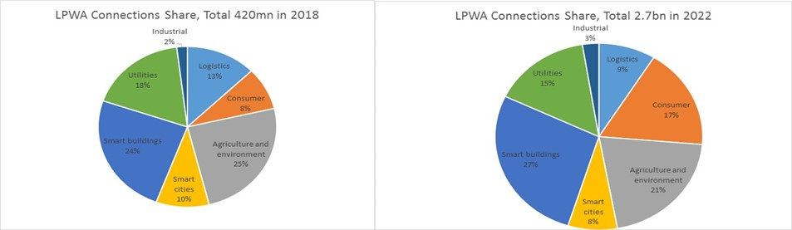
LPWA IoT Market Analysis
2.7 billion connections and annual connectivity revenue will reach US$7.5 billion by 2022
LPWA Market is large enough for an individual UE category but avoiding fragmentation is essential to the success of CIoT.

Slide 7
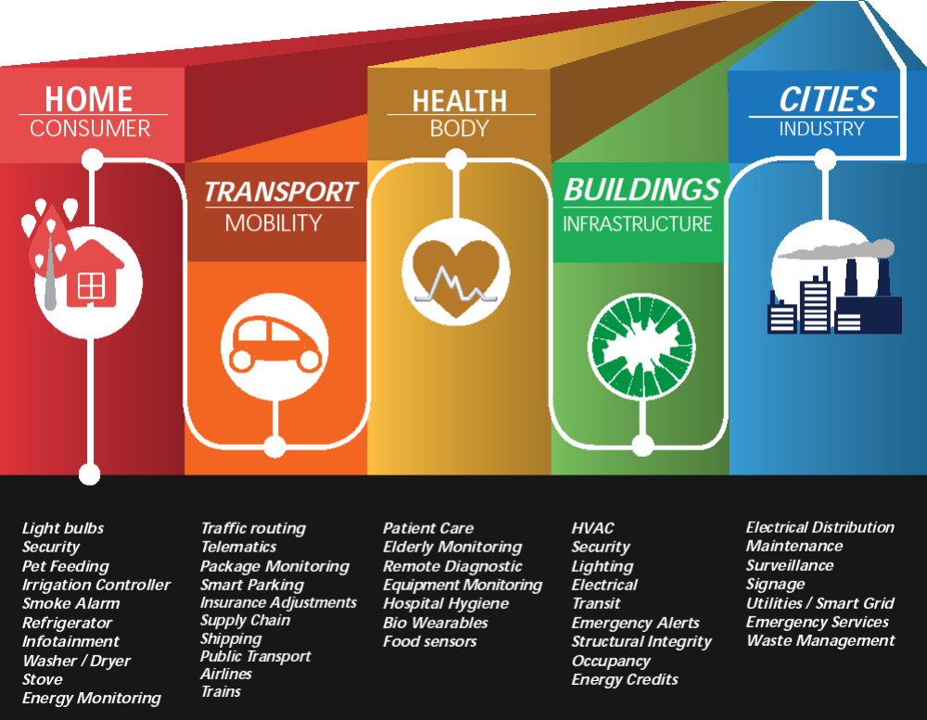
Diverse Applications
Source HarborResearch.com
Notes:
Wide range of Solutions and Applications possibilities
Automotive: Telematics, Maintenance, Safety, Driver behaviour…..
Home/Building: Metering, Appliances, Lighting and HVAC, Access Control, CCTV….
Health Care: Tele medicine, monitoring, Assisted living, Preventive and disease management……
Energy: Metering, Generation, substations……
Industrial, Logistical and Maintenance, Commerce, Infrastructure..

Slide 8
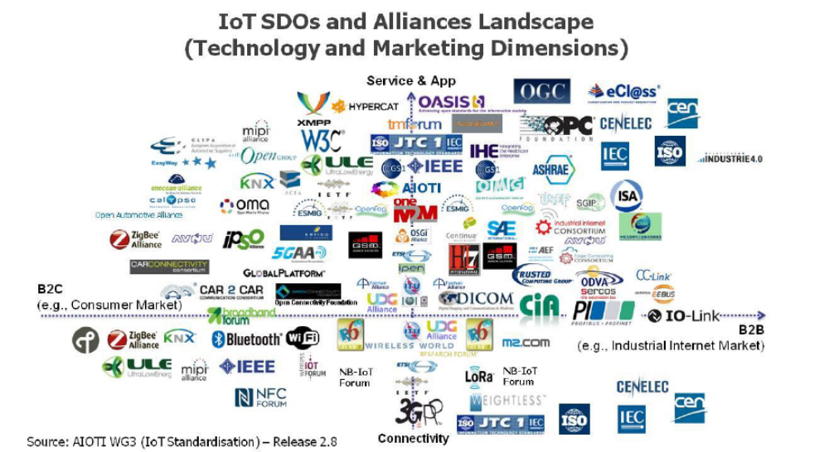
IoT standardization landscape
Notes:
Key challenges:
Fragmentation, provisioning/efficiency, integration complexity, scalability
M2M Communications meets non-ICT Industry [Automotive, Health, Energy..]
Make intelligent use of information, enabled by connected IT [Cloud..]
SDO/Fora roadmaps are not coordinated, and compete on similar subjects

Slide 9
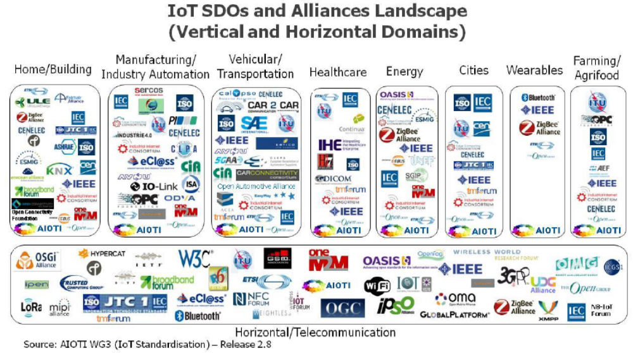
Many related vertical and horizontal activities
Notes:
While IOT/M2M/IOE is a huge topic ranging from last mile connectivity all the way to data models and semantics, One cannot expect the work to focus in a single place. The following list contain few examples, many more exist:
Alljoyn – open source project
ETSI / oneM2M
IEEE P2413—Standard for an Architectural Framework for the Internet of Things, IETF , ISA 100 (Industrial IOT)
ISO/IEC JTC1 /WG7: project named IOT RA covering Sensor Network Reference Atchitecture
ITU Y 2066 and Y2067: Recommendation about IOT covering Requirements and Gateway capabilities
OpenInterconnect , ZigBee, Z-Wave (wireless protocol for home automation)etc.
Key challenges:
Fragmentation, provisioning/efficiency, integration complexity, scalability
M2M Communications meets non-ICT Industry [Automotive, Health, Energy..]
Make intelligent use of information, enabled by connected IT [Cloud..]
SDO/Fora roadmaps are not coordinated, and compete on similar subjects

Slide 10

AIOTI
February 2015, the IoT industry together with the European Commission launched the Alliance for IoT Innovation (AIOTI) as a new global voice for IoT .
AIOTI is the biggest IoT stakeholder forum in Europe.
In 2016, transformed into a legally recognized Association 21 Founding Members, >200 regular members in AIOTI on 11 October2017
AIOTI is a driver for the H2020/EC funded IoT Large Scale Pilot (LSP) projects
With EC plans to have 7 LSPs covering Smart City, Wearables, Farming, Smart Living and Ageing Well Being, Autonomous Vehicle in Connected Environment, Smart Water and Smart Manufacturing (All part of H2020 IoT calls)
Promotion of interoperability based Standards between applications
AIOTI WG03 Reports on IoT Standards

Slide 11
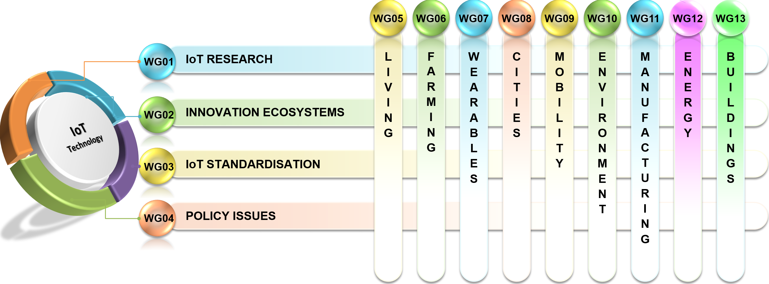
AIOTI Working Group Structure

Slide 12
IoT in 3GPP
Work had began from 3GPP Release 10, MTC (Machine Type Communication) requirements: MTC device overload control;
  Rel11 feature - MTC device triggering;
  Rel12 feature - recall/replace device triggering, power saving mode.
In Release 13 3GPP has made a major effort to address the IoT market
The portfolio of technologies that 3GPP operators can not use to address their different market requirements includes:
  eMTC: Further LTE enhancements for MTC, building on the work started in Release-12 (UE Cat 0, new power saving mode:PSM)
  NB-IOT: New radio added to the LTE platform optimized for the low end of the market
  EC-GSM-IoT: EGPRS enhancements which in cobination with PSM makes GSM/EDGE market prepared for IoT
  Protocol specification finalised now

Slide 13

  Non-standard IoT v.s. Cellular IoT
 | Standard /Global ecosystem | Band | System Bandwidth | Coverage | Module cost | Battery life | Capacity | Time to market (years)
SigFox | O | Unlicensed | 250kHz~ ?MHz UL 100Hz | GSM 14dB+ | X |  | Lower than NB-IoT | P
LoRa | O | Unlicensed | 7.8k~500kHz | GSM 18dB+ | X |  |  | P
EC-GSM (R13) | P | GSM band | 2.4MHz | GSM ~20dB+ | 2X |  | About 1/10 of NB-IoT per unit BW | 1~2
eMTC (R13) | P | LTE band | 1.4MHz | LTE 15dB+ | 3~10X |  | Similar as NB-IoT | 1~2
NB-IOT (standalone) | P | G/U/L MSR /dedicated | 200kHz | GSM 25dB+ | X |  | >50k/cell/200kHz | 1~2
NB-IOT (guard-band) | P | LTE band | 200kHz | GSM 20dB+ | X |  |  | 1~2
NB-IOT (in-band) | P | LTE band | 200kHz | GSM 17dB+ | X |  |  | 1~2
Notes:
eMTC (Enhanced Machine. Type Communication)
Extended Coverage (EC-GSM)
SIGFOX, THE GLOBAL CELLULAR CONNECTIVITY FOR THE INTERNET OF THINGS.
Multi-Standard Radio (MSR)

Slide 14
ETSI Specialist Tasks Force STF 505 - IoT
The European Commission runs the EU Research and Innovation program Horizon 2020. It supports the emergence of an eco-system capable of delivering the Internet of Things with actions like
  Validation of IoT technologies and approaches through Large Scale innovation Pilots (LSPs);
  Identification of required standards in support of global deployments and interoperability in order to support the LSPs
  ➔ For this purpose ETSI has been tasked to provide two reports on
  “IoT Standards Landscaping“ and “IoT European LSP gap analysis“;
  ETSI TC SmartM2M launched a Specialist Task Force (STF505) to
  proceed this task

Slide 15
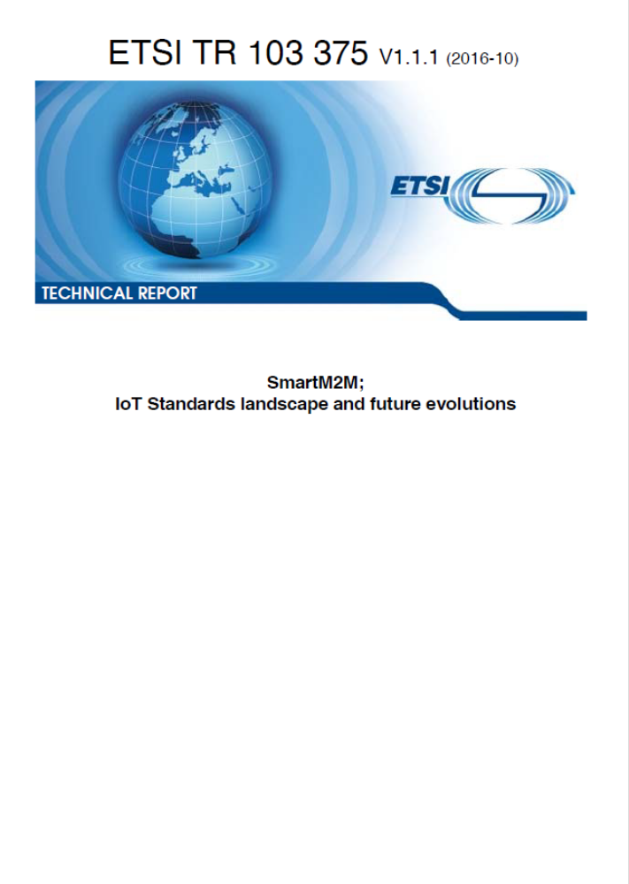


ETSI TR 103375 and TR 103376 published
Analysing the standards landscape provides a list of existing standardised technology suggested for reuse by the LSPs
Identifying technical standards/ societal/business gaps as a good indication of the level of maturity of standardization in a given vertical domain
http://www.etsi.org/deliver/etsi_tr/103300_103399/103375/01.01.01_60/tr_103375v010101p.pdf
http://www.etsi.org/deliver/etsi_tr/103300_103399/103376/01.01.01_60/tr_103376v010101p.pdf

Slide 16
ETSI TC M2M to SMARTM2M
ETSI TC M2M was established 2008 and first set of M2M platform standards in 2011 covering areas such as Smart Grid & Meter, Smart City, M2M Architecture, Smart Automotive, Connected Consumer, e-health, Security etc.
July 2012: ETSI M2M work (Release 1), transferred to oneM2M partnership project, formed the basis for developing future releases for the world
  M2M activities have now been addressed by one Partnership Project (*) oneM2M Release1 published last year and Release2 publications anytime soon
ETSI M2M is renamed as SMARTM2M
  Identification of EU policy and regulatory requirements on M2M services and applications and the conversion of the oneM2M specifications into European Standards.
  Provide Support to AIOTI Initiative, in particular the WG3 (standardization)
  Strategic Topic & scope now include Smart City, e-Health and Smart Appliances, Smart BAN – Body Area Network covering health, wellness, leisure, sport
  (*) ETSI Partnership Project of the same nature than 3GPP

Slide 17
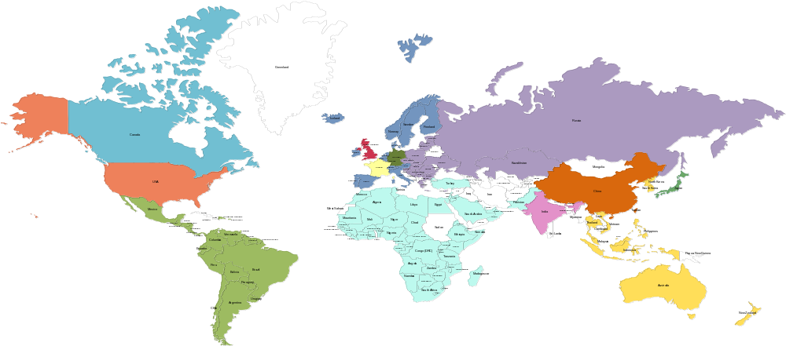

















oneM2M Partnership Project
Over 200 member organizations in oneM2M
www.oneM2M.org
All documents are publically available
Source: oneM2M
17
9
© ETSI 2017. All rights reserved
Notes:
oneM2M is a global partnership project, between 8 of the world’s leading ICT standards development organizations, 7 other partners (standards development organizations like CEN and CENELEC who have recently joined, or OMA, Broadband Forum, GlobalPlatform etc.)
Over 200 companies have participated in the development of the oneM2M specifications. – a set of 10 specs. Published in January 2015, recently updated in 2016. The specifications are all published by the 8 partner standards bodies, making a common set of IoT/M2M specifications across North America, Europe and Asia.

Slide 18












































200+ members organizations
Some of the 200+ active members of oneM2M
Notes:
This is just a small sample of the type of company that is a member of oneM2M.
NIST is an associate member, this is a category specifically created for government t or regulatory agency that has an interest in the development of oneM2M standards.

Slide 19





















Nobody can do it alone
  Collaboration is important to reach common understanding, avoid overlap and build interoperable IoT ecosystems globally.
Sharing/Reference (Liaison, workshop, …)
P2413
MIoT
Certification
ref. arch, OHTP
JTC1 WG10
SCP, SmartM2M
OCF
SCEF/CIoT
SG20
OSGi/DAL
WG3
WoT
HTTP/ CoAP/ (D)TLS/ WebSocket
AllJoyn
OMA DM/ LWM2M
DDS
OPC-UA
TR-069/ TR-181
MQTT
Interworking
Endorsement (adoption)
Partnership

Slide 20
M2M Common Service Layer in a nutshell
A software “framework”
Located between the M2M applications and
communication HW/SW that provide connectivity
Provides functions that M2M applications
across different industry segments commonly need
(eg. data transport, security/encryption, remote software update...)
Like an “Android” for the Internet of Things
But it sits both on the field devices/sensors and in servers
And it is a standard – not controlled by a single private company

Slide 21
oneM2M Architecture approach
Pipe (vertical):
1 Application, 1 NW,
1 (or few) type of Device
Point to point communications
Horizontal (based on common Layer)
Applications share common service and network infrastructure
Multipoint communications
Application
Application
Application
Application
Business
Application
Common Service Layer
Common
Service Layer
Communication
Network (wireline, wireless, Powerline ..)
Communication
Network 1
Communication
Network 2
Things representations (including semantics)
IP
Gateway
S
Gateway
Local NW
Device
A
Device
Local NW
A
S
A
Device
Device
S
A
A
Device
A
Things
S
Common Service Layer
A
Application

Slide 22
Summary of
Release 2/3 Features
Industrial Domain Enablement
  Time series data management
  Atomic Transactions
  Action Triggering
  Optimized Group Operations
Home Domain Enablement
  Home Appliance Information Models & SDT
  Mapping to existing standards (OCF, ECHONET, GoTAPI...)
Smart City & Automotive Enablement
  Service Continuity
  Cross resource subscriptions
Management
  M2M Application & Field Domain
  Component Configuration
Market Adoption
  Developer Guides
  oneM2M Conformance Test
  Feature Catalogues
  Product Profiles
oneM2M
Rel-2/3
Features
Semantics
  Semantic Description/Annotation
  Semantic Querying
  Semantic Mashups
  oneM2M Base Ontology
oneM2M as generic interworking framework
  3GPP SCEF
  OMA LWM2M
  DDS
  OPC-UA
  Modbus
  AllJoyn/OCF
  OSGi
  W3C WoT
Security
  Dynamic Authorization
  End to End Security
  Enrollment & Authentication APIs
  Distributed Authorization
  Decentralized Authentication
  Interoperable Privacy Profiles
  Secure Environment Abstraction

Slide 23









Strong implementation base
  Industry-driven Open source implementations
  Examples of Commercial implementations /demos
  Release 1 interoperability event (Sept’ 2015)
  Release 2 interoperability event (Nov’2016) – interworking & smart city
IotDM

Slide 24
M2M/IoT – Updates: India
DOT released M2M roadmap
  M2M communication standards, Numbering Plan, QoS, Roaming, M2M Service Provider (MSP) registration process, KYC, SIM transfer, Frequency Band, Pilots, Certification, capacity building and Innovation etc.
Meity released its IoT Policy
DoT released M2M Service Providers Registration Guidelines
TRAI CP on M2M
  Recommendation released
TEC work: Technical Reports
  M2M/ IoT Technical Reports covering Gateway & Architecture, Power Sector, Automotive (Intelligent Transport System) Sector, Remote Health Management, Safety & Surveillance Systems, ICT deployment and strategies for India’s Smart Cities: A Curtain Raiser, Number resource requirement & options, V2V / V2I Radio communication and Embedded SIM, Spectrum requirements for PLC and Low power RF communications, Smart Homes and Communication Technologies

Slide 25
M2M/IoT - Updates: India
IoT4SCTF working on Smart City RFP models/guidelines
TSDSI work : Technical Reports & Joined oneM2M Partnership Project & 3GPP
  CDOT has developed oneM2M based Common Service Layer
BIS Panel on ICT New & Emerging Technology
  Panel 1: Title–Internet of Things (IoT) Monitoring work carried out at ISO/IEC/JTC1 WG10 covering Internet of Things, Big Data, Sensor network and Wearable devices. Panel work has now been transferred to LITD TC
IET IoT Panel
  Global Advisory Board and Core Panel
  Horizontal: Standards, Legal & Regulatory, Skill Development & Social Impact
  Vertical: Telecom, Energy, Healthcare, Smart living, Smart Transportation and Ganga Rejuvenation

Slide 26
Conclusions
ICT Standards need to be global considering the fact of interoperability
Avoid fragmentation, work together and develop together Specification for M2M/IoT/Smart City:
  OneM2M Partnership Project & 3GPP
Common Service Layer is important and critical for its implementation as part of Smart Cities & oneM2M is global and interoperable standard
Project SESEI is here and is available to work with all.
  DoT, MeitY, TEC, TSDSI, BIS, IOT4SCTF etc..
Notes:
2012-05-02
26

Slide 27
Thank you!
Contact Details:
Dinesh Chand Sharma
(Seconded European Standardization Expert in India)
Director – Standardization, Policy and Regulation
European Business Technology Centre, DLTA Complex, South Block, 1st Floor, 1, Africa Avenue, New Delhi 110029
Mobile: +91 9810079461, Tel: +91 11 3352 1500, dinesh.chand.sharma@sesei.eu
www.sesei.eu

