Slide 1
India’s Digital Infrastructure
(Status & Standardization)

Slide 2
Contents
European Project SESEI in India
India at a glance
Indian Standardisation System
    Latest Update & Market Access
Digital Infrastructure
    Key Policy Initiative & Standardisation
    Challenges
Conclusion

Slide 3
European Project SESEI in India

Slide 4
SESEI project & its Priority Sector
Co-financed by ESO, EC, EFTA (ca. 1 MEUR), Lead by ETSI and Project Steering Committee monitor the project progress
Project Objectives:
    to promote the European standardization model, best practices and standards in India and facilitate dialogue
    to improve contacts between partners and relevant players in the Indian administration, industry and standardization bodies
    to monitor and gather regulatory and standardization intelligence and raise level of awareness
    to facilitate technical discussions
    to build and animate a network of specialists (among stakeholders and stakeholder’s memberships) capable of addressing specific and/or technical issues;
    To help EU/INDIA Industry on queries around Standards & Reg.
Priority Sectors: Automotive, ICT, Electrical Equipment incl. Consumer Electronics and Smart Cities

Slide 5
India at a glance
Growing Economy

Slide 6
India at a glance
Population : 1.324 billion
GDP 2.26 Trillion Dollar
CO₂ emissions – 1.73 metric tons per capita (world = 4.97) %
Main industry sectors : textiles, chemicals, food processing, steel, transportation equipment, cement, mining, petroleum, machinery, software and pharmaceuticals
Notes:
Source - https://data.worldbank.org/indicator/EN.ATM.CO2E.PC?locations=IN-1W
Some of these figures explain some of the main Indian government initiatives (next slide)
e.g. Co2 emission ➔ environmental cleaning, smart cities)
Industry sectors – source - http://www.economywatch.com/world_economy/india/industry-sector-industries.html

Slide 7
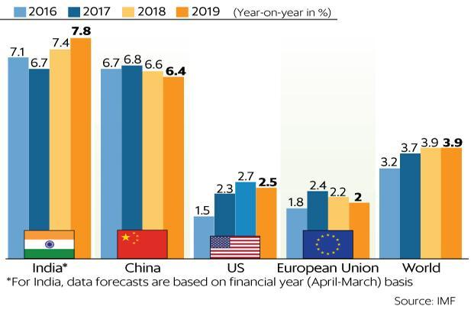
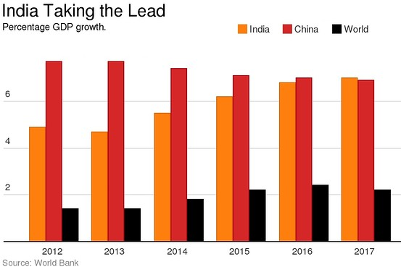
India – Fastest Growing Economy
India transcended into a fastest growing economy
New reforms, policy changes, and new vision of the Indian Government.
As per the World Bank’s India is the world’s fourth fastest growing economy
India’s (GDP) grew 7.6 % in 2015-16, up from 7.2 per cent a year ago.

Slide 8
Indian Standardisation System
Latest Update & Market Access

Slide 9



Main Standardization bodies in India
Indian Standardization
Bureau of Indian standards (BIS)
Telecommunication Standards Development Society for India (TSDSI)
Telecommunication Engineering Centre (TEC)

Slide 10
Bureau of Indian Standards (BIS)
BIS Division Council
PGEDC
Production
MHDC
Medical, Hospital
1
MEDC
Mechanical
Management System
MSDC
Bureau
Standards Advisory Committee
TEDC
Transport
Chemical
CHDC
1
ETDC
Electro-Tech
Petroleum, Coal
PCDC
Division Council
14
LITDC
ICT
Civil
CEDC
Sectional Committees
334
TXDC
Textile
Water Resources
WRDC
Panels/ Subcommittees
977
FADC
Food & Agriculture
Metallurgical
MTDC

Slide 11
BIS - Latest Developments 1(2)
BIS ACT 2016: Replaced 1986 bill
  To include goods, services and systems, with services for the first time
  Self-certification/declaration: Registration scheme (CRO), new standard mark to promote make in India (Zero Defect and Zero Effect)
    Bring more products under the mandatory standard regime
  Beyond ISO/IEC membership/MoU
BIS Rules 2018
  Concurrent Running of Indian Standards,
  Adoption of other Standards as Indian Standards
  Recognition or accreditation of Institutions engaged in standardization
  Standard Mark, Appointment of agents etc.

Slide 12

BIS - Latest Developments 2(2)
BIS (Conformity Assessment)Regulations, 2018
Conformity Assessment Schemes for Products & Grant of license to use standard mark, Initially evidence of conformity:
  For Scheme A: through Testing of Samples in Factory by Bureau
  For Scheme B : through Testing of Samples in Factory by Bureau and in Laboratory
  For Scheme C : through Testing of Samples in Factory by Bureau and in Laboratory (Certification of Lot)
  For Scheme D : through Test Report of Samples submitted by Applicant from Laboratory owned or as approved by Bureau and Testing of Samples in Factory by Bureau
  For Scheme E : through Self-Declaration and Test Report of Samples submitted by Applicant from Laboratory

Slide 13
Indian National Standardisation Strategy: INSS
Harmonization of National Standards with International Standards: Make in India Success
Encourage and recognize self-regulation mechanism & adopt Good regulatory practices: CRO/CRS Scheme step in the right direction
Conduct regulatory impact assessment and implement concept of Essential Requirement: Legislation shall refer to essential requirement and nor the entire standard
Set up a recognition scheme for SDOs, Inclusive participation, Service Standardisation, Capacity building (EaS) etc.

Slide 14
Telecommunication Standards Development Society of India - tsdsi
TSDSI General Body
  Comprises of the entire membership
R&R, Working Procedures and IPR Policy approved by General Body
Functions:
Develop standards to support new requirements based on research & innovation
Take Indian requirements to global standards organizations;
Creating and Safe-guarding related IPRs;
transparent, open-to-all-members process for making standards.
Providing guidance and leadership to other developing countries
TSDSI Governing Council
  16 elected members representing various telecom verticals
  5 nominated members by Ministry of Communications and Information Technology
Two Study Groups:
  Study Group: Networks : Wireless communication systems , Overall system architecture as well as the protocol interface, Software defined networking (SDN) aspects and Network function virtualization (NFV), Backhaul using wireless & wireline, microwave, optical and/or packet based transport networks, Spectrum studies, Interference studies
  Study Group: Services & Solutions : M2M , Indian Languages, Energy Efficiency , Security

Slide 15
Telecommunication Engineering Centre (TEC)
TEC is the engineering wing of DoT under Ministry of Communication
TEC Functions:
Specification of common standards with regard to Telecom network equipment, services and interoperability.
Prepare and Publish Generic Requirements (GRs), Interface Requirements (IRs).
Issuing Interface Approvals, Certificate of Approvals, Service Approvals & Type Approvals.
Formulation of Standards and Fundamental Technical Plans.
Interact with multilateral agencies like APT, ETSI and ITU etc. for standardization.
Provide technical support to DOT and technical advice to TRAI & TDSAT.
Coordinate with C-DOT on the technological developments in the Telecom Sector for policy planning
Divisions of TEC
Fixed Access (FA)
Information Technology
IT
Terrestrial Wireless Access ( TWA)
Future Networks
(FN)
Telecom Security Assurance
(TSA)
Radio ( R)
Next Generation Switching (NGS)
Transmission
( T)
Internet of Things ( IoT)
Green Passport

Slide 16
Market Access
WTO-TBT: While BIS is an enquiry point, Dept. of Commerce is the notification authority in India
  53 TBTs - 133 items are under mandatory certiication covering Chemicals & Fertilizers, Electrical Motors, Transformers, Steel Products, Medical Equipments, Cylinder, Valves and Regulation, Automobile Accessories, Oil Pressure Stoves, Batteries, Foods, and Household Electrical goods, Cement
  49 are Under CRO covering Electronics & IT products

Slide 17
Digital Infrastructure
Key Policy Initiative & Standardisation

Slide 18
Indian government initiatives
Environmental clean up (“Clean India”)
Support for Startups (“Start up India”)
Manufacturing (“Make in India”)
Electrification & its Modernisation
National Electric Mobility Mission Plan 2020
Digital India
100 Smart cities by 2020
Notes:
The new government at helm, announced massive projects of national importance namely Swachh Bharat (Clean India), Start up India, Skill Development for the Youth, Building 100 Smart Cities , “Make in India” Campaign and many more. Its foremost agenda is to create conducive policy and investment environment for the industries, generate new employment opportunities and give more emphasis on the skill sector development.
On the global front, India is the only economy standing among the much-touted BRICS, with estimates suggesting that the country has overtaken China as the world’s fastest growing economy. At a time when major global economies are shrinking against the backdrop of a strong US dollar and falling commodity prices, India remains one of the few bright spots with its economic growth reaching over 7 per cent in 2017. India has also replaced China as the top destination for foreign investment (FDI) last year, largely on account of the push from the Modi government to increase manufacturing in the country.
Clean India – objectives:
To make India clean through behavioural change.
To promote idea of Smart City. A city needs to be clean before it becomes smart.
To eliminate the burden of communicable disease which India has like Malaria, Diarrhea, Cholera.
To fulfil SDG Goal 6 of UN: Ensure availability and sustainable management of water and sanitation for all.
To emphasize on the fact that clean mind and body reside in clean environment.
To effectively and efficiently handle waste generated. People are encouraged to separate wet and dry garbage for this.
Start up India objective - to empower Startups to grow through innovation and design and to accelerate spreading of the Startup movement.
Make in India – objective - to promote India as the most preferred global manufacturing destination
Electrification - The Indian Government has launched Deen Dayal Upadhyaya Gram Jyoti Yojana scheme on 25th July 2015 with the aim of electrifying Indian villages. To achieve this, the Government initially allocated budget of Rs. 500 crore and eventually has increased budget allocation to Rs. 4,814 crores. Till now total 13,267 villages are electrified. Also Indian Government has launched GARV II App for real-time monitoring of electrification. So Deen Dayal Upadhyaya Gram Jyoti Yojana is also one of the key initiatives of Indian Government.
Digital India – objective - to transform India into a digitally empowered society and knowledge economy. Create synergies between the "Digital India" initiative and the EU's “Digital Single Market”, in particular by cooperating on economic and regulatory issues (e.g. market access), ICT standardisation, Internet Governance, research and innovation as well as innovative start-up companies ("Startup Europe India Network") and by making good use of the annual Joint ICT Working Group and Business Dialogue. Paragraph from the EU-India Agenda for Action 2020. http://www.europarl.europa.eu/cmsdata/122862/20160330-agenda-action-eu-india.pdf

Slide 19

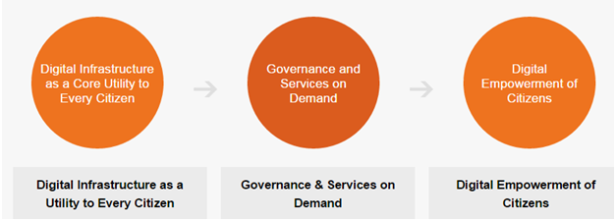
Digital India
Understanding the need for creating a digitally connected and empowered society.
Digital India programme launched on 1st July 2015 by Prime Minister
Vision of Digital India Centered on 3 Key Areas

Slide 20
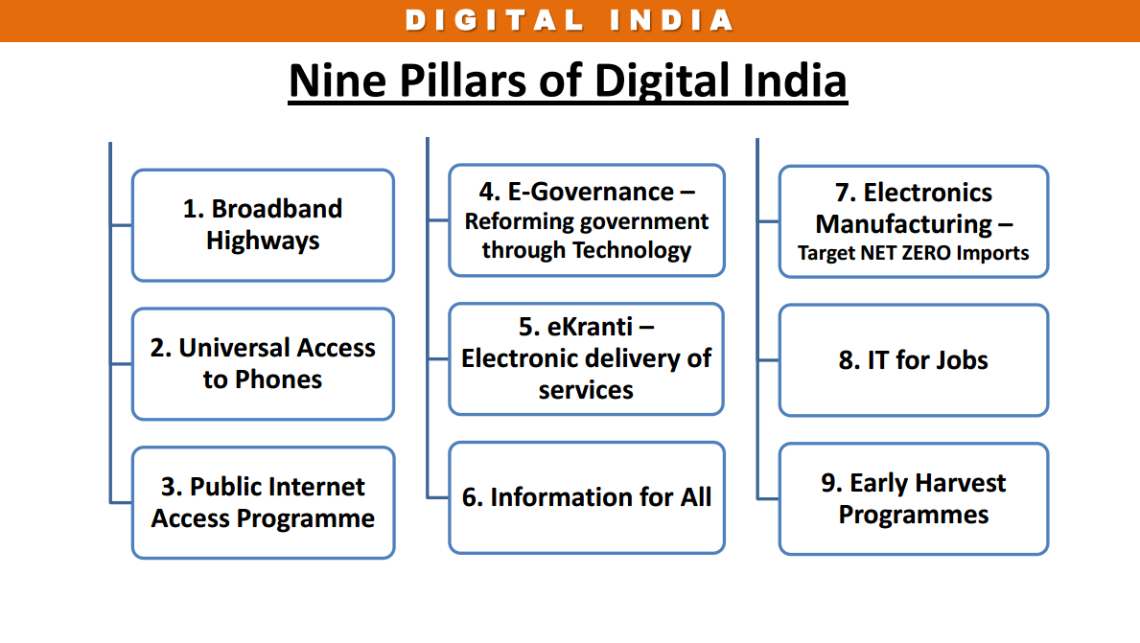
Nine Pillars of Digital India
Each Pillar has its own set of deliverables and goals
Impact of Digital India by 2019 :
Broadband in 2.5 lakh villages, universal phone connectivity
400,000 Public Internet Access Points
Wi-fi in 2.5 lakh schools, all universities; Public wi-fi hotspots for citizens
Digital Inclusion: 1.7 Cr trained for IT, Telecom and Electronics Jobs
Job creation: Direct 1.7 Cr. and Indirect at least 8.5 Cr.
e-Governance & eServices: Across government
India to be leader in IT use in services – health, education, banking
Digitally empowered citizens: public cloud, internet access

Slide 21
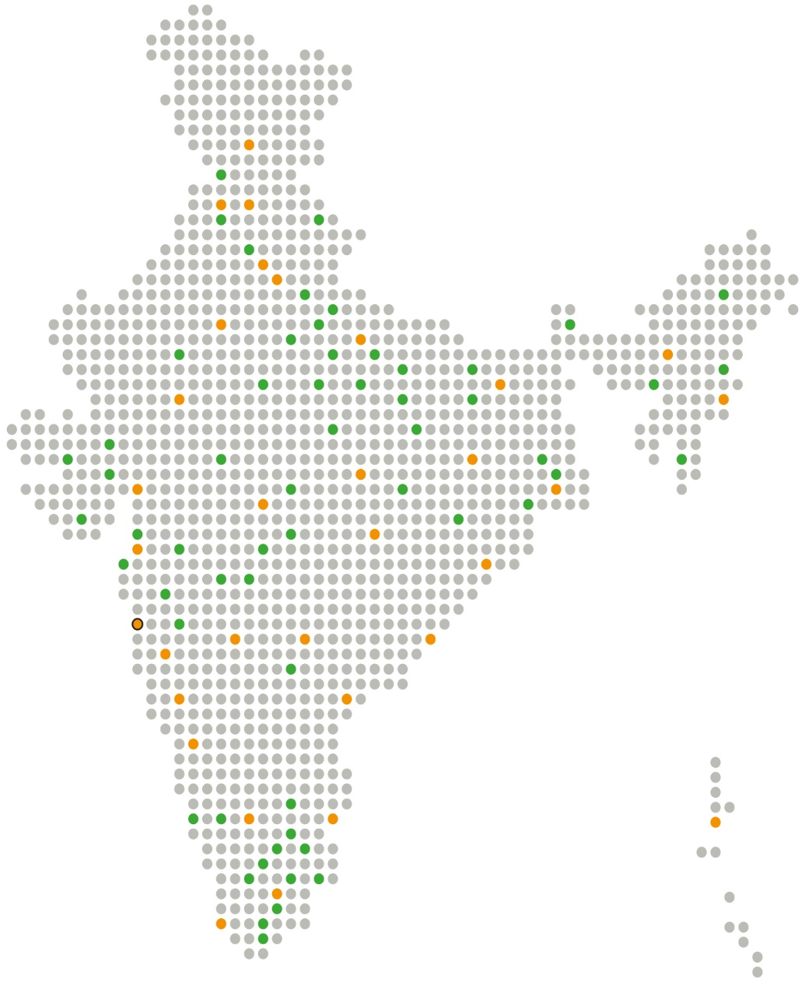
Smart City Mission
PM Modi launched 100 smart cities mission On 25th June 2015.
Create core infrastructure
Provide a decent quality of life
Build clean and sustainable environment and application
Over Rs. 48000 cr (6.4B Euro) allocated to Smart Cities for next 5 years.
Smart City Mission- Strategies :
City Improvement (Retrofitting)
City Renewal ( Redevelopment)
City Extension ( Greenfield)
Pan City Initiatives ( Smart Solution)
Smart City Mission- Convergence with other Government Schemes:
Atal Mission for Rejuvenation and Urban Transformation (AMRUT)
Heritage City Development and Augmentation Yojana (HRIDAY)
Swachh Bharat Mission (SBM), Digital India and Housing for All
Dharamshala
Ludhiana
Chandigarh
New Delhi
Faridabad
Jaipur
Lucknow
Guwahati
Udaipur
Bhagalpur
Imphal
Bhopal
Ranchi
Jabalpur
New Town, Kolkata
Indore
Raipur
Bhubaneshwar
Solapur
Visakhapatnam
Warangal
Panaji
Kakinada
Devangere
Bengaluru
Chennai
Port Blair
Coimbatore
Kochi

Slide 22

Smart Cities – ICT/IoT Standardization: WIP
TEC, DOT
Reference framework for Indian Smart cities
(Technical Specification of) Smart City Data Model
(General characteristics of) City Planning & Assistance Tools
BIS
Smart City Proposals Review & identifying pain points and gap areas (ICT).
ICT Reference Architecture & Framework for Smart Infrastructure
Communication Architecture
TSDSI
Overview of Smart Cities and Use Cases
IoT Use case identification in 10 verticals
IoT4SCTF
Use Case Analysis
Reference Architecture
RFP Guidelines

Slide 23
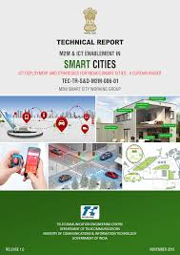
TEC Work on Smart Cities
TEC M2M/ IoT TRs covering:
  Gateway & Architecture
  Power Sector
  Automotive (Intelligent Transport System) Sector
  Remote Health Management
  Safety & Surveillance Systems
  ICT deployment and strategies for India’s Smart Cities: A Curtain Raiser
  Number resource
  V2V / V2I Radio communication and Embedded SIM
Spectrum requirements for PLC and Low power RF communications
Smart Homes
COMMUNICATION TECHNOLOGIES in M2M / IoT Domain

Slide 24
Work done by TSDSI
  TSDSI WG on IoT/M2M published report covering Indian Use cases:
Smart Utilities
Environment Pollution Monitoring & Control
Smart Cities
Smart Governance
Remote Asset Management
Smart Villages
Transportation
Industrial Automation
Smart Homes
Smart Health
TSDSI transposed 3GPP Specifications and oneM2M Specifications

Slide 25
BIS - Smart Infrastructure Panel
Smart infrastructure panel - LITDC/P2
liaison with Regional/International Org.
to explore work at international level and identify the need for standardization at the national level in areas of:
  Smart City
  Smart Energy
  AAL (Active Assisted Living)
  Smart Manufacturing – Industry 4.0
  Communication Technologies
  Disruptive Technologies
maintains a liaison with ISO, IEC, ITU, IEEE & other Global SDOs like oneM2M etc.:
  ISO/IEC JTC 1/SG1/WG11: Smart Cities
  IEC SEG 1/SyC SC: Smart Cities
  IEC SEG 3/ SyC AAL: Active Assisted Living
  IEC SyC: Smart Energy
  IEC SMB/SG 8: Smart Manufacturing
  IEC SMB/SG9: Communication Technologies
  IEC ahG 60: Disruptive Technologies
  ITU-T SG 5 & SG 20: Smart Cities & IoT
  IEEE Working Groups: Smart Cities & IoT
  oneM2M : Common Service Layer
Notes:
Standardization Testing and Quality Certification (STQC)

Slide 26
Bureau of Indian Standards (BIS) 1(2)
Electronics and Information Technology (LITD)
LTD 10 : Power system Control and associated Communications
  Smart Grid
LTD 27 : Internet of Things and Related Technologies:
  To develop standards in the field of Internet of Things and related technologies including sensor networks; wearable electronic devices and technologies; big data.
LTD 28 : Smart Infrastructure:
  Standardization in the field of Smart Cities (Electro-technical and ICT aspects) including Smart manufacturing, Active assisted living.
LTD 29 : Blockchain and Distributed Ledger Technologies
LTD 30 : Artificial Intelligence

Slide 27
Bureau of Indian Standards (BIS) 2(2)
Civil:
CED 45: Smart Cities Indicator
  ISO 37120: Sustainable cities and communities -- Indicators for city services and quality of life.
Electrotechnical:
ETD13: Equipment For Electrical Energy Measurement And Load Control
  Smart Meter Standards
ETD 51 : Electrotechnology in Mobility
  Standard for Electric Car Charger
Transport:
TED 28: Intelligent Transport Systems

Slide 28
Digital Infrastructure
Challenges

Slide 29
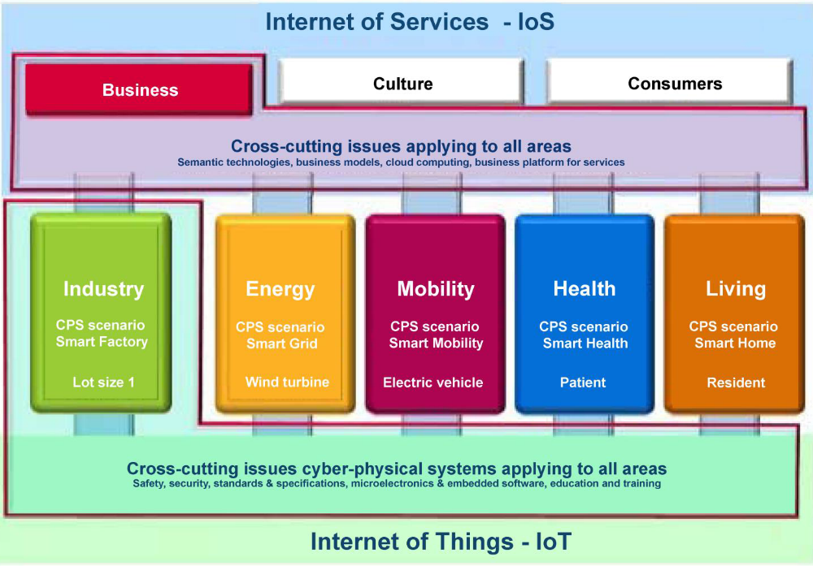
The world is changing - Digitization
The Challenges:
  changing economy: growing importance of services
  Digital transformation, convergence: Everything is becoming Smart – ICT [IoT]
  Data Privacy and Security
To remain relevant, standards must be timely, market-driven and produced in an inclusive way quickly

Slide 30
What can/should we do?
Awareness, Education and Understanding about the Standardisation System i.e. increasing the use of standards and participation in the process at all levels
  Education About Standardisation
Coordination, Cooperation, Transparency, Inclusiveness, i.e. ensuring adequate, high-quality, user-friendly and timely release standards
  ESOs CGs on Smart Energy, Smart Cities, Accessibility, Mobility etc.
  Joint President Groups
Competitiveness and International dimension, i.e. standards supporting competitiveness in the global markets.
  Yearly Work Program, Roadmap, Participation and Contribution to Research Program (H2020)

Slide 31
Conclusion

Slide 32
Conclusions
Standardisation is a form of self regulation and is a tool to create markets as large and homogenous as possible and to achieve economies of scale
  Self Declaration & strong Market Surveillance is a best way forward and CRS/CRO is a right step forward in this direction
  Encourage Voluntary Standards Compliance practice to enhance the product quality ready for domestic consumption and exports: Make in India
Regulation/Legislation and mandatory standards (essential requirement) shall be supported by:
  Impact assessment and sufficient transition period of 2-3 year to help industry get prepared with its proper implementation
ICT Standards need to be global considering the fact of interoperability: SDOs shall work together on topic of convergence - ICT
Standards Portfolio Harmonization with Global Standards (Make In India), raising awareness and visibility ( Increased Member Participation) plays an important role in strengthening global trade
  Regular, Consistent participation of team of same experts is vital
Notes:
2012-05-02
32

Slide 33

Dinesh Chand Sharma
(Seconded European Standardization Expert in India)
Director – Standardization & Public Policy
SESEI C/O EBTC, DLTA Complex, Gate No 3, 1st Floor, 1, Africa Avenue, New Delhi 110029
Mobile: +91 9810079461, Tel: +91 11 3352 1525, dinesh.chand.sharma@sesei.eu
www.sesei.eu ⬄ www.sesei.in

